Slide 1
Introduction to Circuits Analysis
by Andrew G. Bell
abell118@ivytech.edu
(260) 481-2288
Lecture 1

Slide 2
PART I
Foundational Concepts

Slide 3
CHAPTER 1
Basic Concepts of Electricity

Slide 4
Careers in Electronics
Technician: Installs, adjusts, troubleshoots, repairs, and maintains equipment and systems
Technologist: Assists in design, development and testing of equipment and systems
Engineer: Designs electronic equipment and systems

Slide 5
Matter
Definition: That which has weight and occupies space
Physical States of Matter: Solid, Liquid, and Gas
Chemical States of Matter: Elements, Compounds, and Mixtures
Composition: Molecules and Atoms

Slide 6
The Atom
Definition: The basic building block of matter
Structure: Similar to solar system
Characteristics: Nucleus and shells
Sub-Atomic Particles: Electrons (in shells), Neutrons and Protons (in nucleus)
Concept of Charge: Characteristic that causes interaction between other charged particles

Slide 7
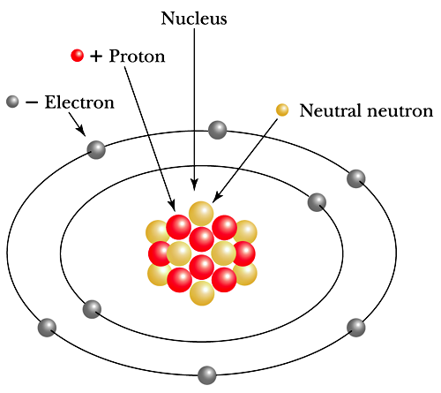
The Bohr Model

Slide 8
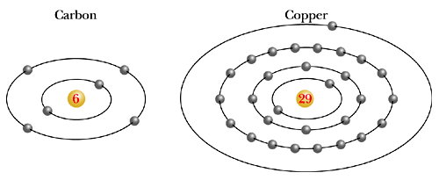
The Copper Atom
The basic structure

Slide 9
The Atomic Model
Electrons:
Negative electric charge
Small mass (9 x 10⁻²⁸ grams)
Travel in orbits around the nucleus at high rates of speed
Help determine chemical characteristics

Slide 10
The Atomic Model (cont.)
Protons:
Positive electrical charge
About 1,800 times heavier than electrons
Located in the nucleus
Equal in number to the atom’s electrons

Slide 11
The Atomic Model (cont.)
Neutrons:
Have no electrical charge
About the same mass or weight as protons
Located in nucleus
May vary in number for a given element to form different isotopes

Slide 12
Molecule
Definition: Smallest part a substance can be divided into and still retain its physical properties.

Slide 13
Valence Band
Valence Band: The outermost shell
Valence Electron(s): Electron(s) in outermost shell
Shell is said to be full when it has eight electrons.
An atom with a full valence shell is said to be stable.

Slide 14
Categories of Materials
Conductors
Many free electrons
Examples: gold, silver, copper
Insulators
Few or no free electrons
Examples: glass, ceramic
Semiconductors
Four valence electrons
Examples: silicon, germanium

Slide 15
Electrical Balance and Separation of Charge
Balanced Atom: Number of electrons equals protons
Unbalanced Atom: Number of electrons does not equal protons

Slide 16
The Ion
Ions are created by adding or removing electrons.
Positive Ion: Number of protons is greater than number of electrons
Negative Ion: Number of electrons is greater than number of protons

Slide 17
Energies that Change Electrical Balance
Friction: Static Electricity
Chemical: Battery
Mechanical Energy: Generator
Light Energy: Photocell
Heat Energy: Thermocouple
Magnetic Energy: Transformers

Slide 18
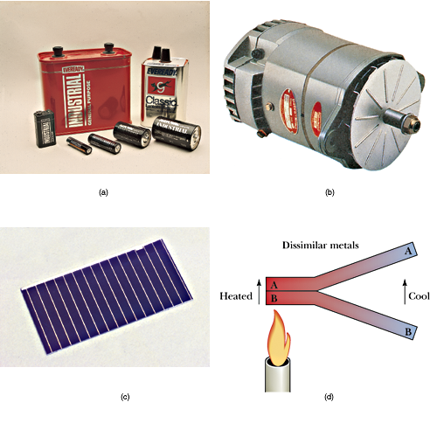
Common Sources of Electrical Energy
Popular sources appear in everyday life

Slide 19
Common Sources of Electrical Energy (cont.)

Slide 20
The Basic Electrical System
Power Source
Supplies energy to the load
Energy Transfer
Typically wires
Load
Converts electrical energy into something useful

Slide 21
Basic Law of Charges
Like Charges and Unlike Charges
Behavior:
Like charges repel
Unlike charges attract
Significance of this is the ability to do work

Slide 22
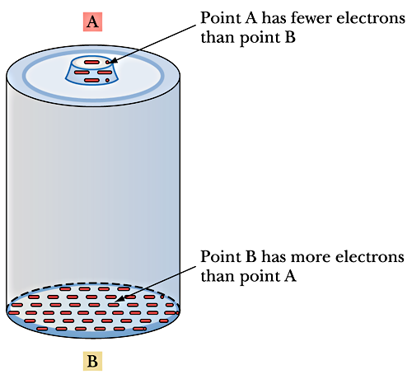
Polarity and Reference Points
Concept of negative (-) and positive (+) charges

Slide 23
Coulomb’s Force Equation
F = force k = constant Q₁ and Q₂ = charge
What happens when charge (Q) increases or decreases?
What happens when the distance between charges (d) increases or decreases?

Slide 24
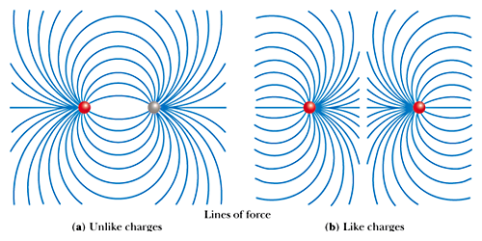
Force Fields Associated with Charged Particles
Lines of force between charges

Slide 25
The Unit of Charge
Measure of Charge: Coulomb
1 Coulomb = 6.25 × 10¹⁸ electrons
The significance of terms Q₁ and Q₂ is found in the force available from the interaction of charges.

Slide 26
Electrical Potential
Concept: Electrical pressure
Definition: Difference in charge
Production of electrical potential is done in many ways.
Unit of Measure: Volt

Slide 27
Electrical Potential (cont.)
Electromotive Force: Electrical potential used to move electrons
Potential Difference: Difference in the amount of charge between two points
Voltage Drop: Difference in the amount of charge between the two ends of a device
Units for All: Volts (V)

Slide 28
Charge in Motion
Current: Flow of charge
Types:
Random Motion: Irregular movement
Directed Motion: Electrons move in a specific direction due to an electrical force
Electron Flow: The directed movement of electrons

Slide 29
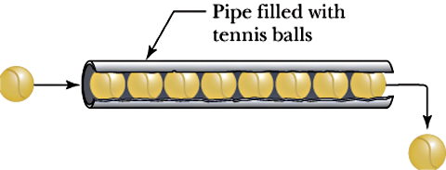
Current Flow
Analogy for the concept of current flow

Slide 30
Current Flow (cont.)
I = current flow (amperes)
Q = charge (coulombs)
T = time (seconds)

Slide 31
Current Flow (cont.)
One amp = One coulomb/second
One ampere = One coulomb flowing past a point in a circuit in one second

Slide 32
Resistance
Definition: Opposition to the flow of charge
Unit: Ohm
Symbol: Ω
Types:
Electrical:
Physical:

Slide 33
Resistance (cont.)
One ohm = One volt / amp
One ohm is the amount of electrical resistance that limits the current to one ampere when one volt of electromotive force is applied.

Slide 34
Fundamental Electrical Quantities
Voltage or Potential Difference
Difference in quantity of charge
Current
Flow of electrons
Resistance
Opposition to the flow of electrons

Slide 35
Relationship of Resistance and Current
For a constant voltage:
As resistance increases, the resultant current will decrease.
As resistance decreases, the resultant current will increase.

Slide 36
Relationship of Voltage and Current
For a constant resistance:
As voltage increases, current increases.
As voltage decreases, current decreases.

Slide 37
The Basic Circuit
Typical Circuit Components:
Source, wiring, load and perhaps a control element such as a switch
Closed Circuit:
Complete path and current is able to flow
Open Circuit:
Current path is broken and no current will flow

